Slide 1

Capstone Project
Melbourne Housing Price Prediction
by – Pasan Dharmasiri

Slide 2
contents
Introduction
Dataset
Exploratory Data Analysis
Model Training
Results

Slide 3
Introduction
In present, real state business is very competitive because the prices of the properties are varying significantly due to several criteria of the property.
Estimating price of a certain property is bit challenging and need to be precise. If the estimated price is higher and it leads to reduce the sales of the company.
A Machine Learning model was developed in this project to determine the estimated value of a certain property using few criteria of the property.

Slide 4
daTASET
This is an open dataset which available in Kaggle and the following table explains the columns of the dataset.
https://www.kaggle.com/anthonypino/melbourne-housing-market
Criteria | Description
Suburb | Suburb of the property
Address | Address of the property
Bedrooms | No. of rooms in the property
Type | Property type (House, unit, Townhouse)
Price | Sold price
Method | Sold method of property (property sold, property sold prior etc.)
Seller | Real Estate Agent
Date | Date sold
Distance | Distance from CBD in Kilometers
Postcode | Postcode of the location
Bedroom 2 | No. of rooms in the property (Alternative source)
Bathroom | No. of Bathrooms in the property
Car | Number of car spots
Land size | Land Size in Meters
Building Area | Building Size in Meters
Year Built | Year the house was built
Council Area | Governing council for the area
Latitude | Latitude of the location
Longitude | Longitude of the location
Region name | General Region (West, Northwest, North, Northeast …etc.)
Property count | Number of properties that exist in the suburb.

Slide 5
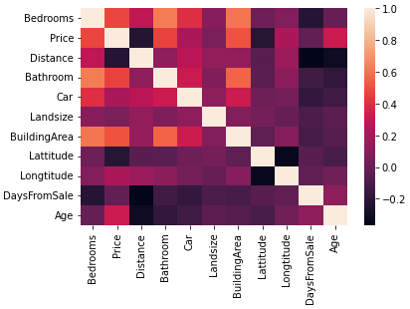
Exploratory Data Analysis
Correlation matrix that used to determine that doesn’t affect to predict price.

Slide 6
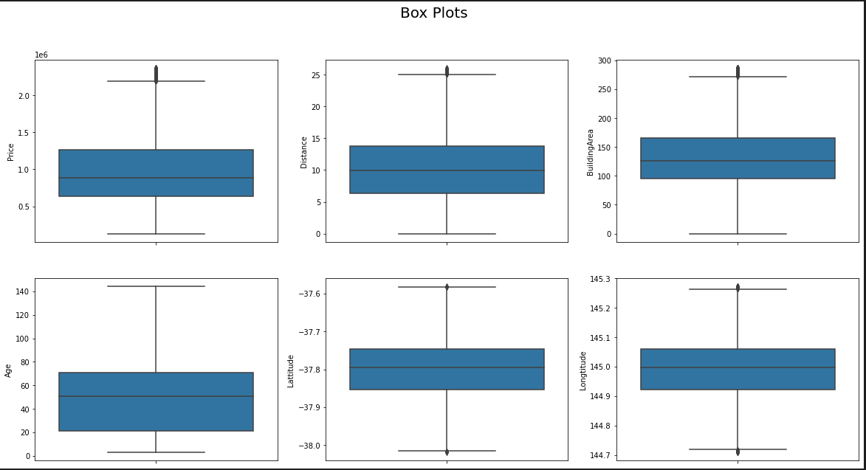
Exploratory Data Analysis
Box plots of numerical data in the dataset after removing the outliers

Slide 7
Model training
Variation of R2 score of Random Forest regression model when changing the hyperparameters.

Slide 8
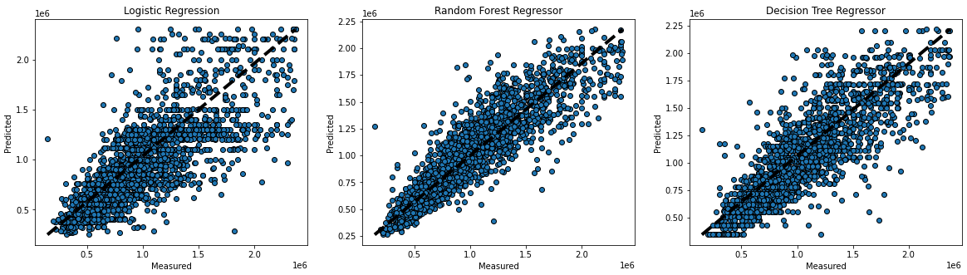
results
Model Name | Mean Square Error | Root Mean Square Error | R2 Score
Logistic Regression | 8.055428e+10 | 283820.864989 | 0.594920
Random Forest Regressor | 3.639213e+10 | 190767.210631 | 0.816997
Decision Tree Regressor | 5.229548e+10 | 228682.056369 | 0.737024
When comparing the performance of the above three models, Random Forest Regressor has the highest score and the minimum error.
The cross-validation figure shows this model performed with low bias and low variance when comparing to the other models

Slide 9

Thank you

